Slide 1


模拟电子技术基础
Analog Device
4 Integrated operational circuit (IOC) 集成运放电路
Qingfeng Zhang 张青峰
Department of Electrical and Electronic Engineering

Slide 2


4.0 Structure of IOC
The structure of the integrated operational circuit (IOC)
Intermediate stage
Input stage
Output stage
Biasing circuit
偏置电路
Intermediate stage中间级: high voltage gain
Use common-e amplifier circuit共射极放大电路 (composite amplifier复合管, Multistage amplifier多级放大电路)

Slide 3
4.1 Multistage amplifier 多级放大电路
Typical specification for a general purpose operational amplifier
1) Input resistance ~ 1MΩ
2) Output resistance ~ 100 Ω
3) Voltage gain ~ 100,000
No single transistor amplifier can satisfy the specification
Cascading multiple stages of amplifier to meet the spec
多级串联放大器可以满足要求

Slide 4
4.1.1 Multistage amplifier circuit
1st stage
2nd stage
(n-1)^{th} stage
n^{th} stage
+
+
+
+
+
+
+
+
R_{s}
R_{o1}
R_{o2}
R_{on-1}
R_{on}
u_{i}
u_{o1}
u_{i n-1}
u_{in}
R_{in}
R_{L}
u_{o}
+
R_{i1}
u_{i2}
R_{i2}
u_{o2}
R_{in-1}
u_{on-1}
u_{s}
_
_
_
_
_
_
_
_
_
Signal
Input stage
Middle amplification stage
Output stage

Slide 5
4.1.1 The coupling mode of multistage amplifier circuit
Coupling mode 耦合方式
1) Direct coupling 直接耦合
2) Resistance-capacitance coupling 阻容耦合
3) Transformer coupling 变压器耦合

Slide 6
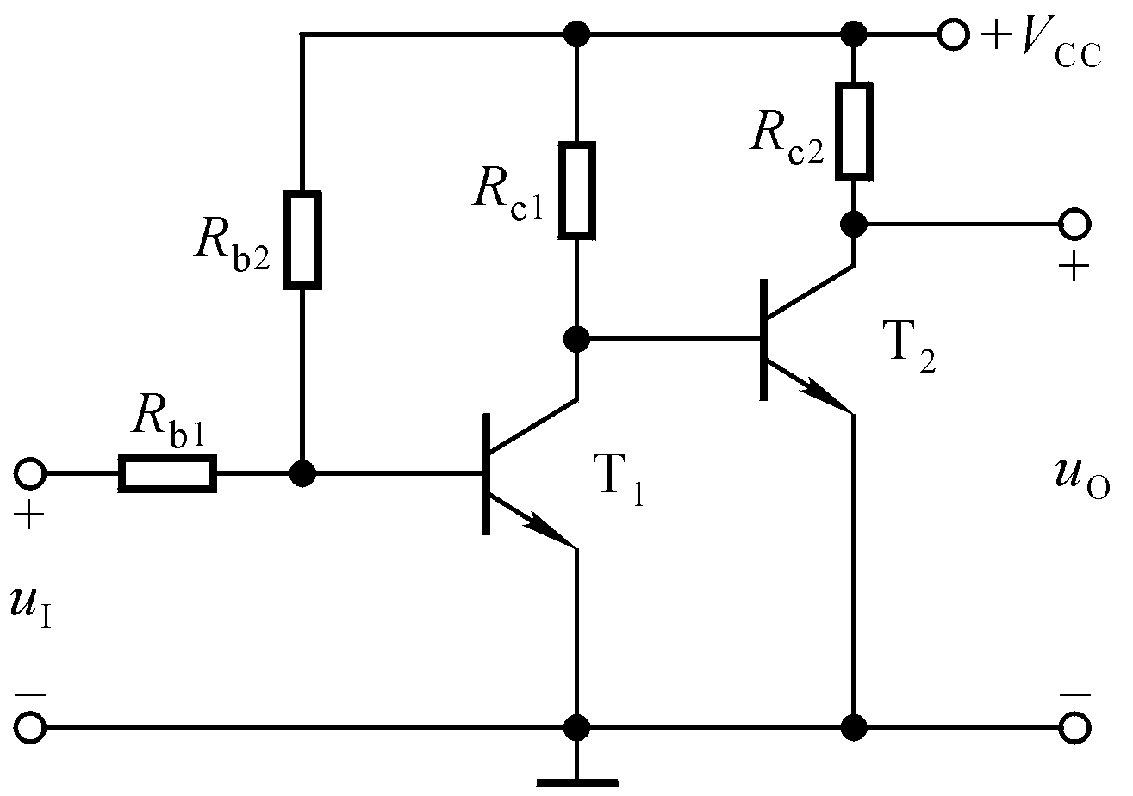
1) Direct coupling circuit 直接耦合电路
Merits of direct coupling circuit:
Can amplify both AC and DC signal
No need of capacitor and inductor, easy to integrate

Slide 7
Drawback of direct coupling circuit:
a) The static working points of T₁ and T₂ are dependent, very inconvenient to design and diagnose the circuit
U_{BEQ2}=U_{CEQ1}
c2
c1
b2
U_{CEQ1} too small, T1 is close to saturation region
e2
b1
e1

Slide 8
How to find a proper static working point of T1?
Raise U_{C1} → U_{B2} → U_{E2}!
Introduce resistor R_{E}
c2
U_{CEQ1}=U_{B2}=U_{BEQ2}+I_{E2}R_{E}
c1
b2
e2
b1
e1
R_{E}
A new problem will be introduced:

Slide 9
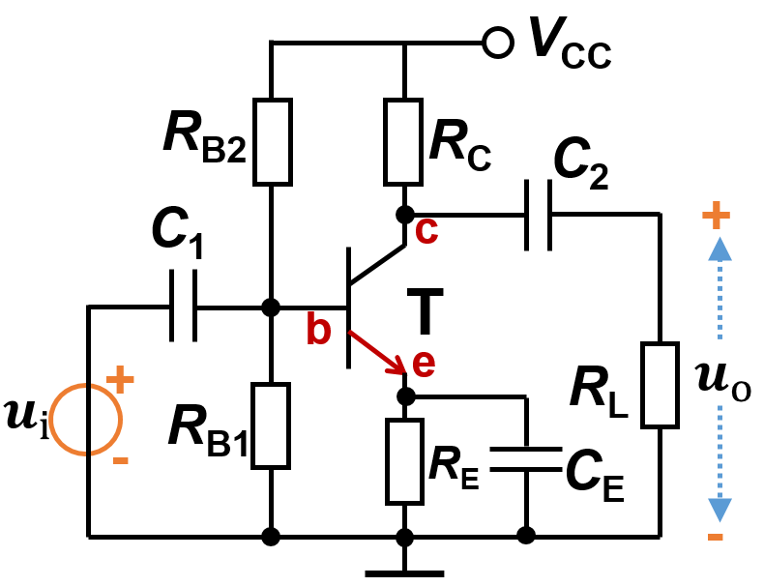
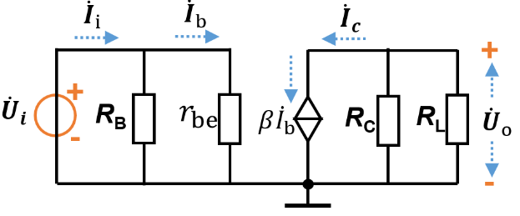
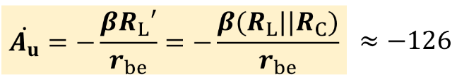
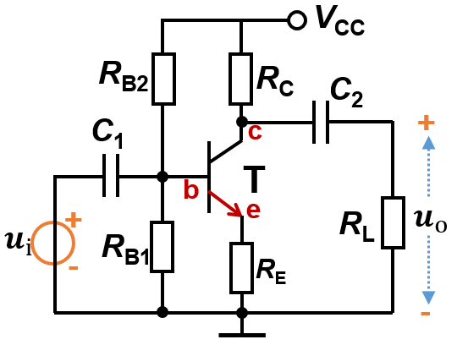
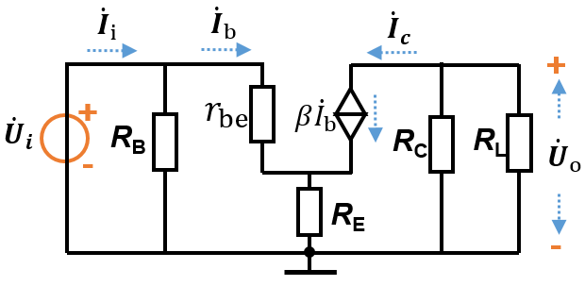
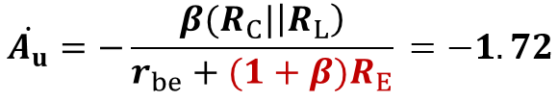
After introducing resistor R_{E}, although we increase the U_{CEQ1}, the voltage gain of T₂ will decrease significantly!

Slide 10
The idea case is: we have a high U_{E2} and small R_{E}
1) If we need U_{CEQ1}<2 V
Use PN diode to replace R_{E}
U_{E2}=U_{ON}+I_{E2}r_{D}
c2
2) If we need high U_{CEQ1}>2 V
c1
b2
e2
Use voltage regulator diode to replace R_{E}
b1
e1
U_{E2}=U_{Z}+I_{E2}r_{Z}
U_{Z} > U_{ON} and r_{Z} < r_{D}

Slide 11
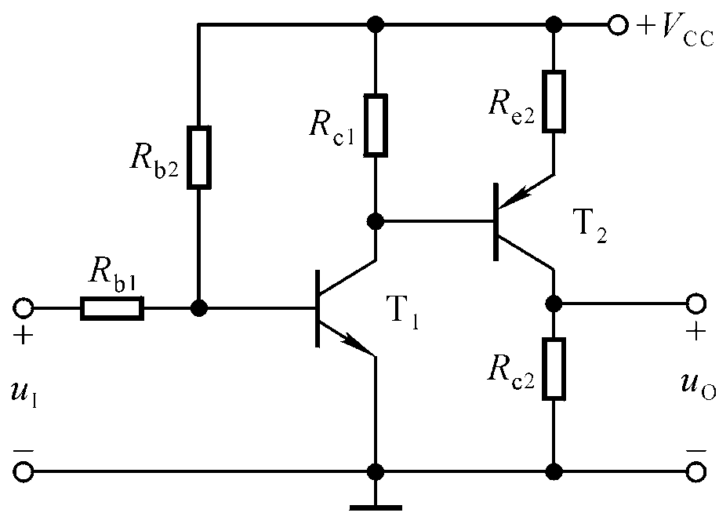
If there are multiple stages:
T1: NPN, T2: PNP, T3: NPN, T4: PNP…
c2
c1
b2
c2
e2
b1
c1
e1
b2
e2
b1
e1
U_{CQ1} (U_{BQ2} )＞ U_{BQ1}
U_{CQ2} ＞ U_{CQ1}
U_{CQN} ＞ U_{CQN-1}…>U_{CQ1}
U_{CQ1} (U_{BQ2} ) ＞ U_{BQ1}
U_{CQ2} ＜ U_{CQ1}
U_{CQ3}>U_{CQ2}, U_{CQ4}<U_{CQ2}…
V_{CC} will be very large

Slide 12
Drawback of direct coupling circuit:
b) Zero-drift error 零点漂移
When input signal u_{I}=0, the output signal u_{O} is not stable, but shows a slow and random variation
Zero-drift error is due to the drift of static working point

Slide 13
Reasons that contribute to the zero-drift error:
a) Temperature
由温度引起的零漂称为温漂
b) Aging
由元器件老化引起的零漂称为时漂
Suppress the zero-drift error:
a) Negative feedback DC circuit 直流负反馈电路
b) Differential amplifier circuit 采用差分放大电路

Slide 14
2) Resistance-capacitance coupling amplification circuit 阻容耦合放大电路
+V_{CC}
R_{B2}
R_{C1}
R_{C2}
R_{B1}
C₂
C₃
+
+
+
C₁
+
T₁
T₂
+
R_{L}
u_{o}
u_{i}
_
_
Merits of RC coupling circuit:
The static working points of T1 and T2 are independent

Slide 15
+V_{CC}
R_{B2}
R_{C1}
R_{C2}
R_{B1}
C₂
C₃
+
+
+
C₁
+
T₁
T₂
+
R_{L}
u_{o}
u_{i}
_
_
Drawback of RC coupling circuit:
Cannot amplify DC and low frequency signal
Cannot be applied to integrated circuits, due to high space consumption of capacitor with large capacitance

Slide 16
3) Transformer coupling amplification circuit 变压耦合放大电路
+V_{CC}
+
R_{B11}
R_{L}
u_{o}
_
R_{B21}
TR₁
TR₂
TR₃
+
T₁
T₂
u_{i}
_
+
+
+
+
R_{E1}
C_{E1}
R_{B22}
R_{E2}
C_{E2}
R_{B12}
C_{E1}
C_{B1}

Slide 17



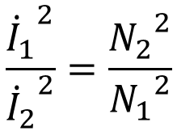


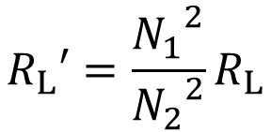
N₁
N₂
R_{L}
Transformer
Conservation of energy:
Use transformer, we can change the load resistance and improve the voltage gain

Slide 18
Merits of transformer coupling amplification circuit:
a) The static working points of every stage are independent
b) Can change load resistance
Drawback of transformer coupling amplification circuit:
a) Cannot amplify DC and low frequency signal
b) Cannot be applied to integrated circuits: large volume, expensive

Slide 19
4.1.3 Analysis of multistage amplification circuit
Direct coupling
+V_{CC}
R_{C1}
R_{C2}
I_{BQ2}
I_{O}
+
I_{CQ2}
+
+
R_{B}
I_{CQ1}
T₁
T₂
+
+
U_{CEQ2}
I_{BQ1}
+
_
R_{L}
u_{O}
u_{i}
U_{CEQ1}
U_{BEQ2}
_
_
U_{BEQ1}
V_{BB}
R_{E}
_
_
_

Slide 20
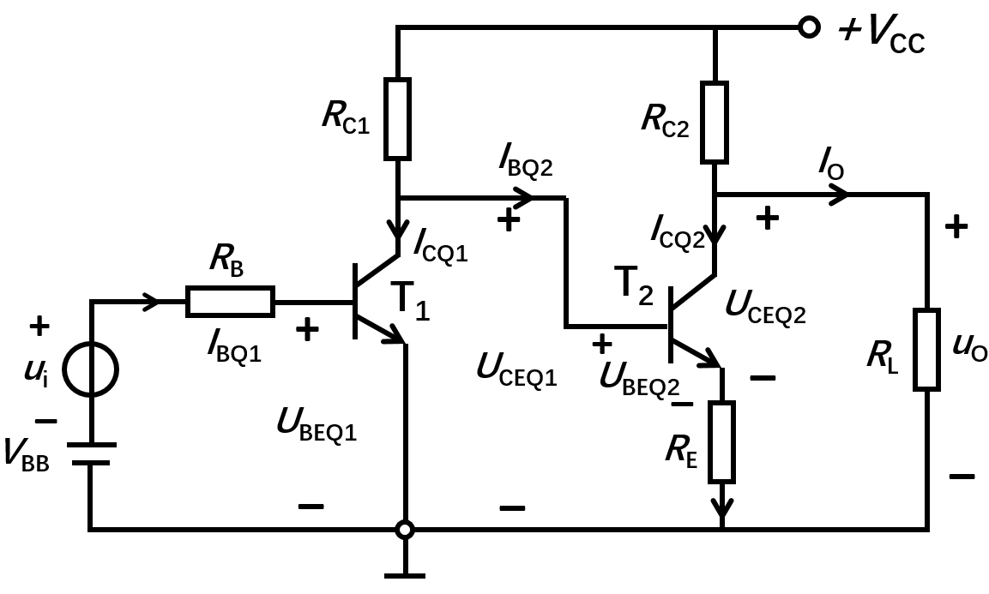
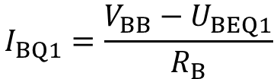




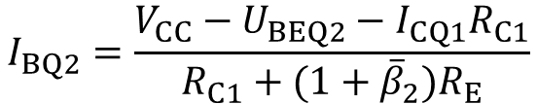




Static analysis
Input circuit of 1st stage
Between 1st and 2nd stage
Output of 2nd stage:

Slide 21
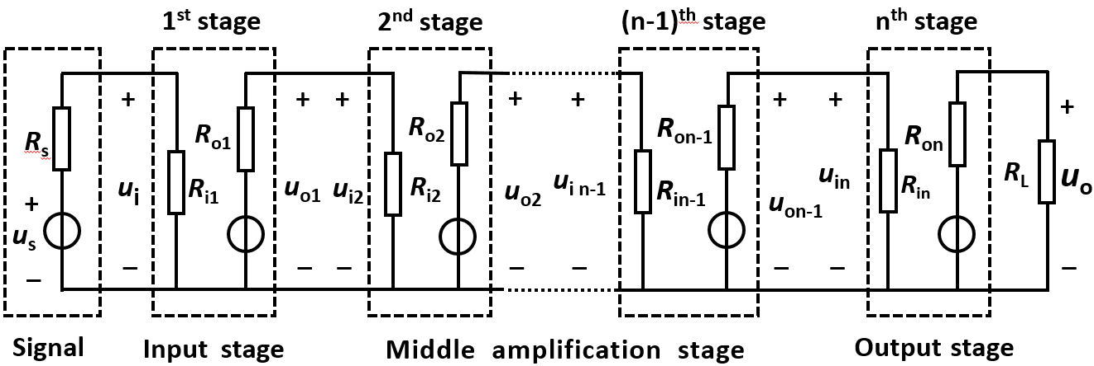
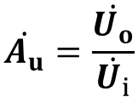
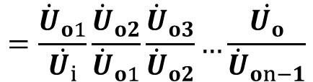



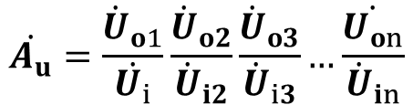
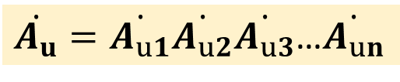
Dynamic analysis:
Voltage gain

Slide 22
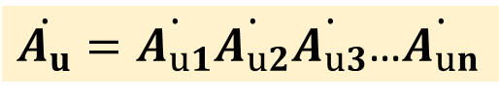
Voltage gain

Slide 23
Input resistance R_{i}
Output resistance R_{o}
The input resistance of n-1 stage can be regarded as the load resistance of n-2 stage
The output resistance of n-1 stage can be regarded as the internal resistance of signal source of n-2 stage

Slide 24
Dynamic analysis of the circuit
+V_{CC}
R_{C1}
R_{C2}
I_{BQ2}
+
I_{CQ2}
R_{B}
I_{CQ1}
T₁
T₂
+
I_{O}
I_{BQ1}
+
u_{i}
U_{CEQ1}
_
V_{BB}
R_{E1}
R_{E2}
R_{L}
u_{O}
_
_

Slide 25








R_{B}
+
+
r_{be1}
r_{be2}
+
R_{C1}
_
+
R_{E1}
R_{E2}
R_{L}
_
_
_
R_{i}
R_{o1}
R_{i2}
R_{o}
R_{B}
r_{be1}
+
+
r_{be2}
+
+
R_{E1}
R_{C1}
R_{E2}
R_{L}
_
_
_
_
R_{i}
R_{o1}
R_{i2}
R_{o}

Slide 26








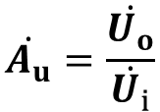

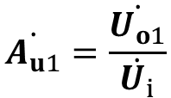


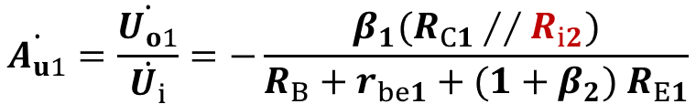

R_{B}
r_{be1}
+
+
r_{be2}
+
+
R_{E1}
R_{C1}
R_{E2}
R_{L}
_
_
_
_
R_{i}
R_{o1}
R_{i2}
R_{o}
Voltage gain：

Slide 27


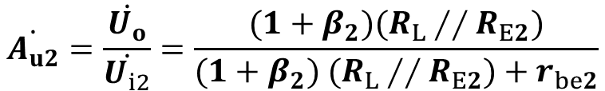
R_{B}
r_{be1}
+
+
r_{be2}
+
+
R_{E1}
R_{C1}
R_{E2}
R_{L}
_
_
_
_
R_{i}
R_{o1}
R_{i2}
R_{o}

Slide 28


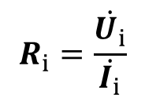



R_{B}
r_{be1}
+
+
r_{be2}
+
+
R_{E1}
R_{C1}
R_{E2}
R_{L}
_
_
_
_
R_{i}
R_{o1}
R_{i2}
R_{o}
Input resistance:

Slide 29

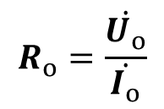

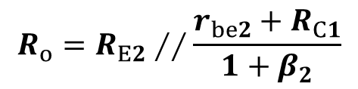

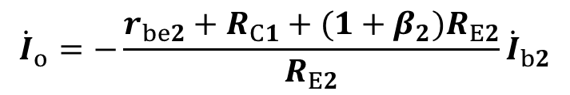
R_{B}
r_{be1}
+
+
r_{be2}
+
R_{E1}
R_{C1}
R_{E2}
_
_
_
R_{i}
R_{o1}
R_{i2}
R_{o}
Output resistance:

Slide 30




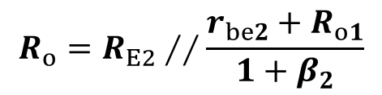

R_{B}
r_{be1}
+
r_{be2}
+
R_{E1}
R_{C1}
R_{o1}
R_{E2}
_
_
R_{o1}
R_{o}
Output resistance:

Slide 31
Homework 3-2：
3.2

